Slide 1
Accelerating translational immunology through data science
Raphael Gottardo
J. Orin Edson Foundation Endowed Chair
Scientific Director Translational Data Science Integrated Research Center
Vaccine and Infectious Disease Division, Fred Hutch
Affiliate Professor, Department of Statistics
University of Washington

Slide 2
Conflict of interests
Past or present consultancy
Merck, Takeda, VentiRx, Celgene, Juno Therapeutics, Infotech Soft, CellSpace Bio
Corporate relationships
Johnson and Johnson, Juno Therapeutics
Honorarium for talks
Merck, Genentech

Slide 3
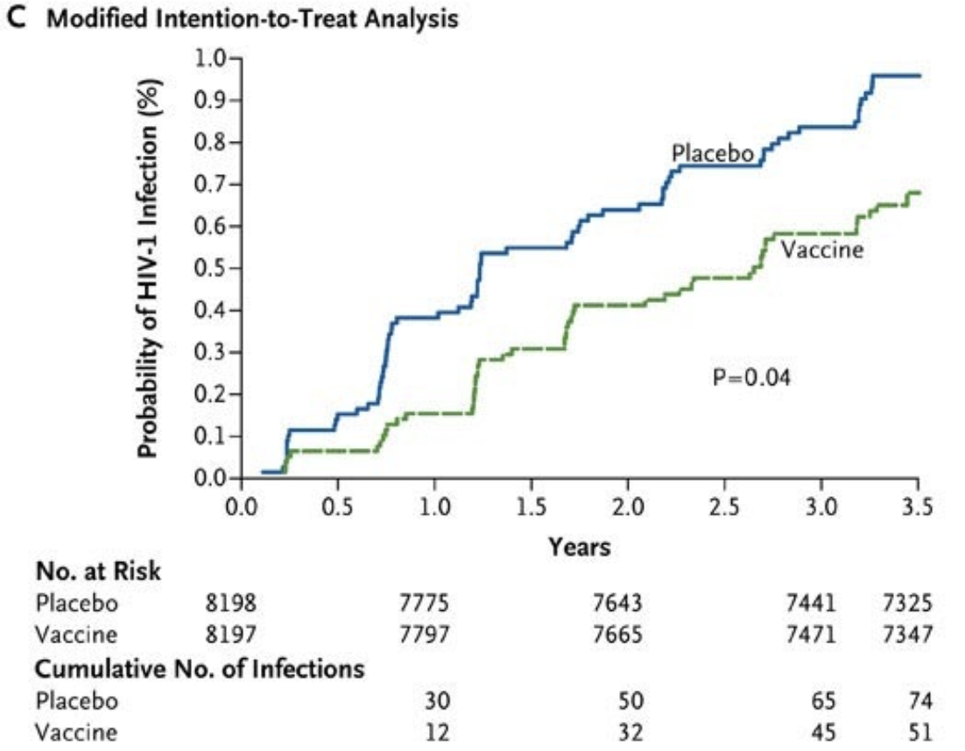
Using data science to improve clinical response
Anti-PD1 therapy in melanoma
~ 50% response rate
RV144 HIV vaccine
~ 30% vaccine efficacy
What’s different between responders and non-responders?

Slide 4
Basics of immune correlate studies
treatment
baseline
weeks/months
years
Correlate with outcomes
(response, side effects)
Immunological assays
(e.g. flow cytometry, scRNA-seq)

Slide 5
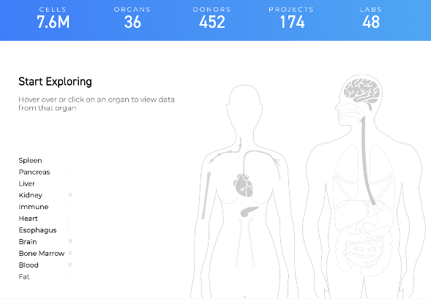
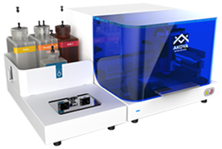
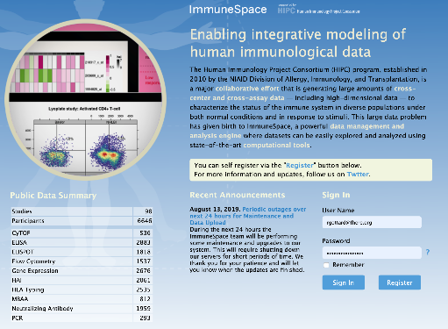
50 years ago
Today
Huge databases
High-dimensional single-cell data
Source:purdue.edu
Computing on demand
New algorithms
Deep
learning
Bayesian
modeling

Slide 6
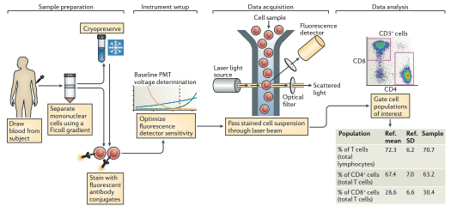
Flow Cytometry: the bread and butter of immunology
Maecker, H.T., McCoy, J.P., Nussenblatt, R., 2012. Standardizing immunophenotyping for the Human Immunology Project. Nat. Rev. Immunol. 12, 191–200.

Slide 7
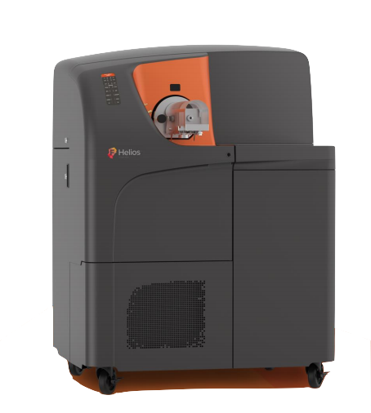
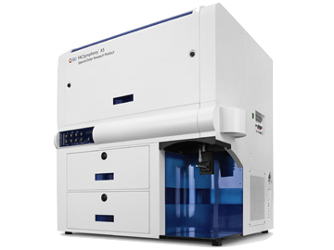
The big data revolution in flow cytometry
New instrumentations
Ability to measure 40-50 proteins
Fluidigm CyTOF
BD FACS symphony
20 proteins: we can define 2²⁰ (> 1 million) subsets
30 proteins: we can define 2³⁰ (> 1 billion) subsets

Slide 8
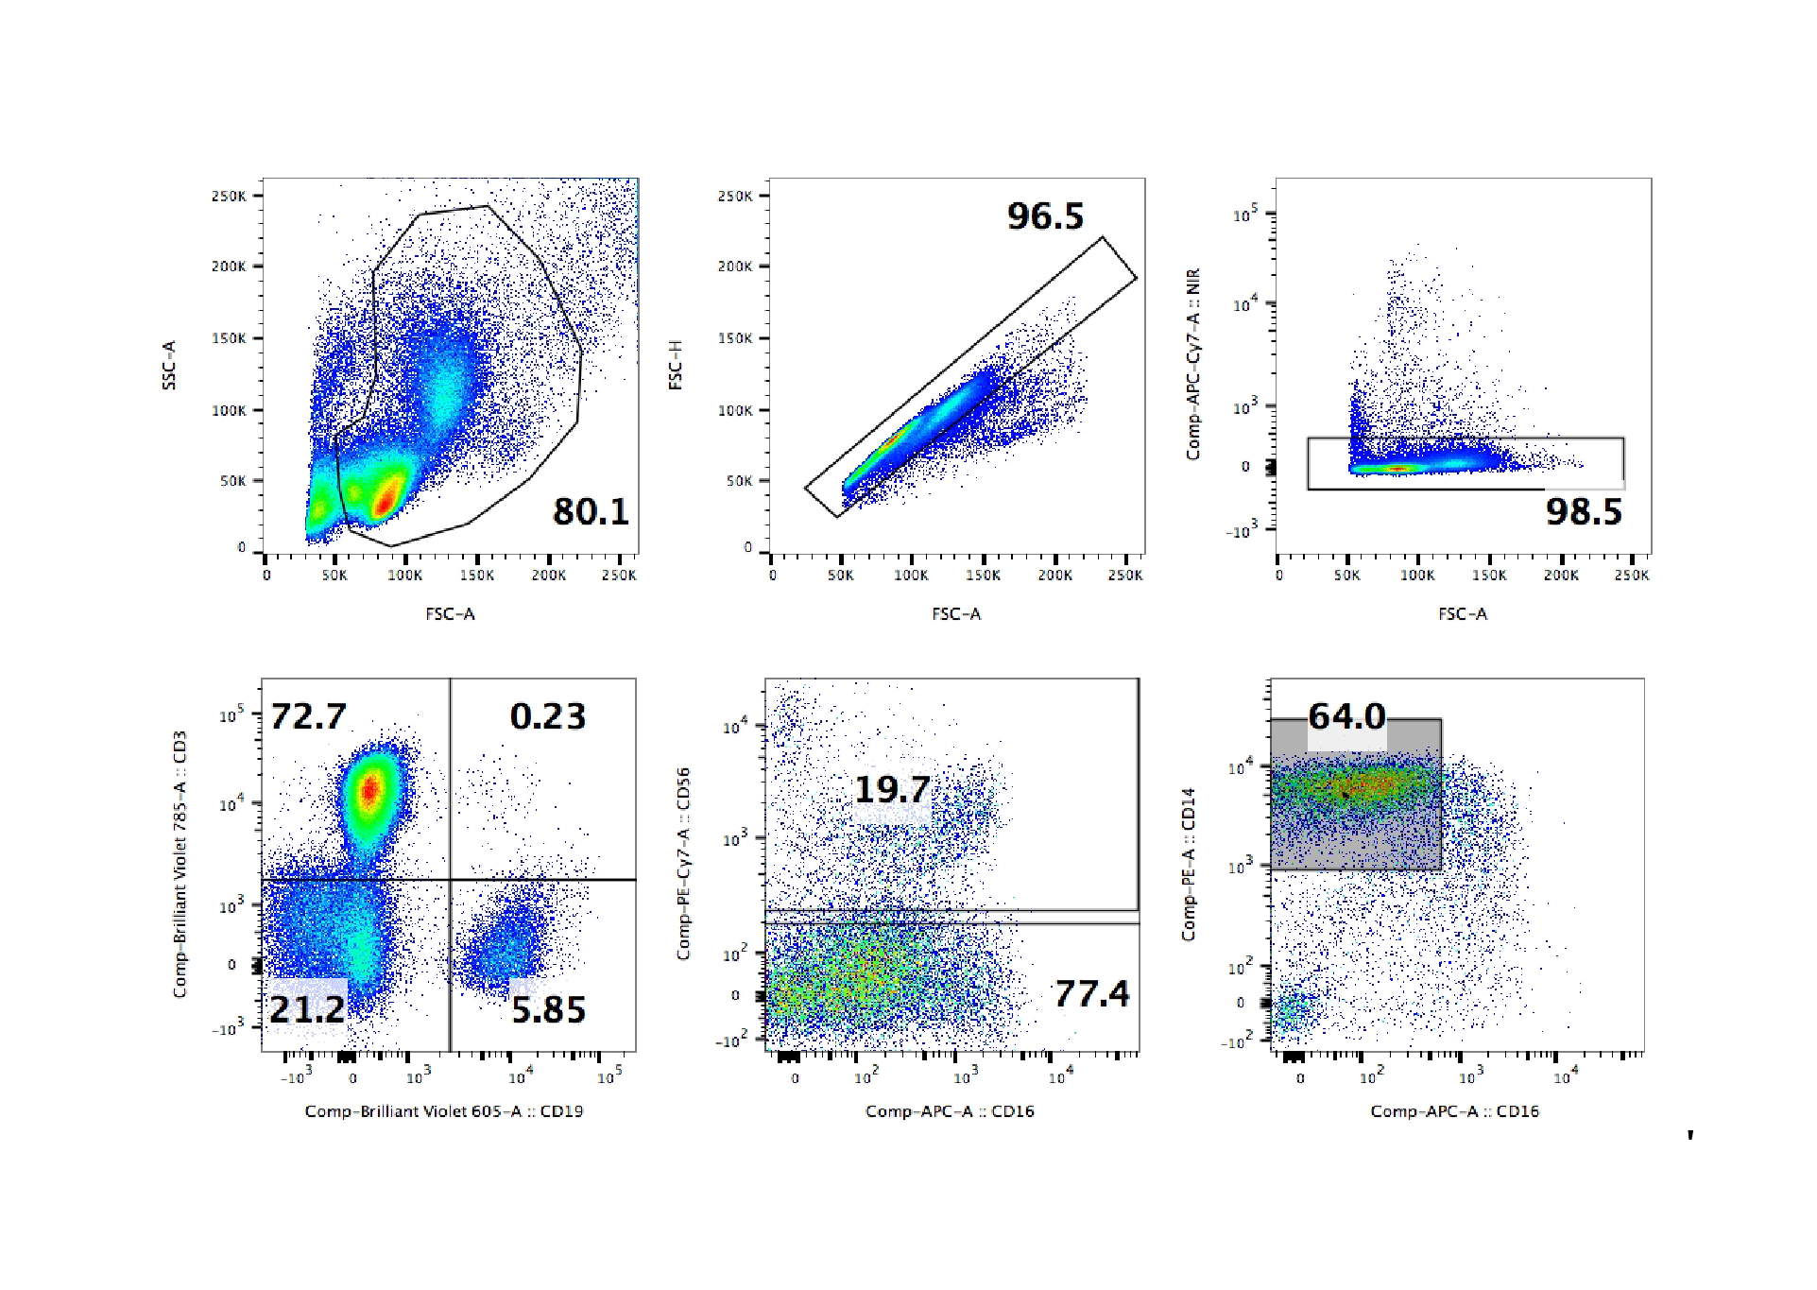
Data analysis: State-of-the-art
Manual identification (gating) of cell populations still common.
Curse of dimensionality
Number of possible cell populations grows exponentially with number of markers (assuming binary expression)
Exploration often limited and biased on prior knowledge
Computational methods successful, with caveats
flowSOM (van Gassen et al. 2015) -- need to set the initial number of clusters
cytometree (Commenges et al. 2018) -- assumes expression measurements follow a Normal distribution
flowLearn (Lux et al. 2018) -- replicates known gating strategies
Put gating picture here
Gating strategy example from Kreig et al (2018)

Slide 9
FAUST: Full Annotation Using Shape Constrained Trees
Key features:
Data driven. Finds all cell populations in the data, and derive optimal gating scheme.
Provides complete phenotypic annotations and cell counts for biomarker screening.
Proposes a gating scheme to validate, verify, or sort discovered populations.
Robust to biological heterogeneity and diverse marker panels, makes it an ideal tool for cross-center/study integration.
Evan Greene

Slide 10
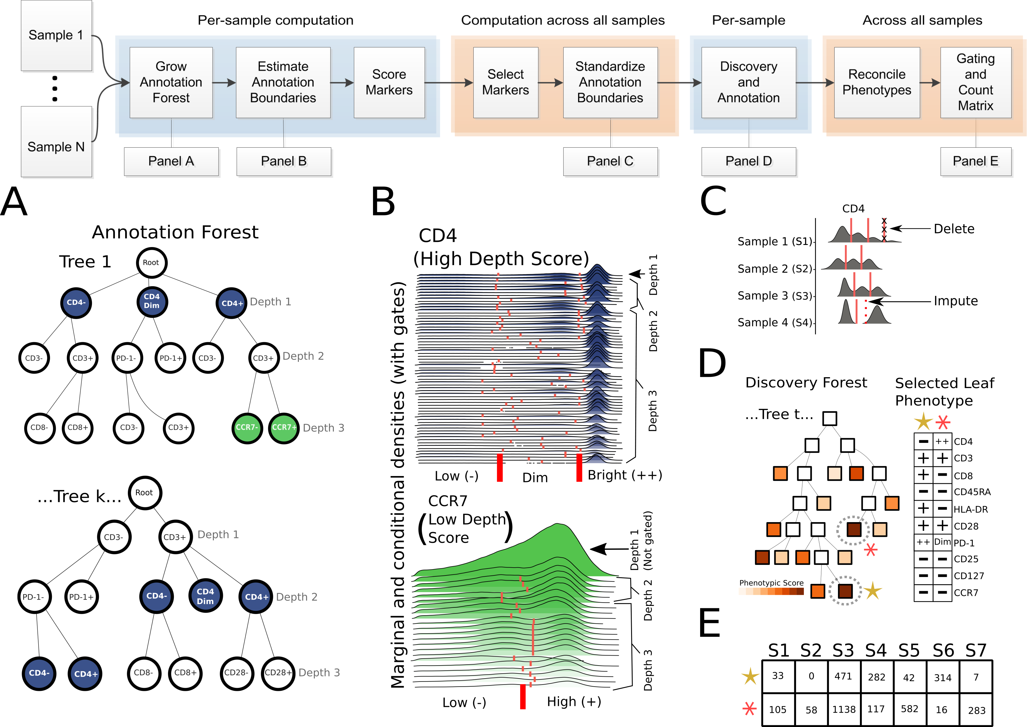

Slide 11
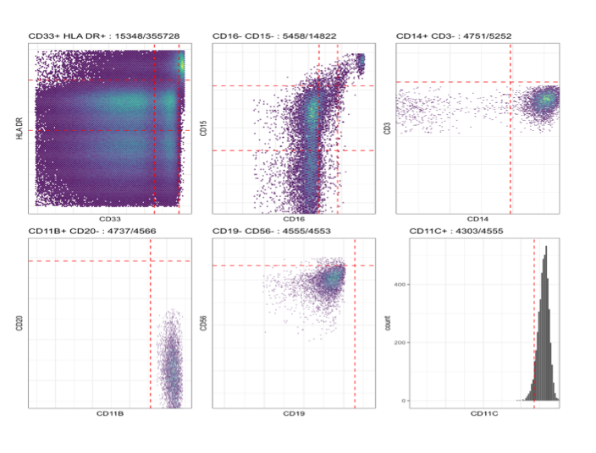
FAUST gates out the discovered cell population phenotypes using the phenotypic boundaries.
Discovered cell populations are verifiable.
Useful for validation or sorting
Markers with better separation at the margins are gated first.
Notes:
Once we have our list of phenotypes, FAUST uses the sample specific but standardized phenotypic boundaries to explicitly gate out the cells matching that phenotype. So we’re back to plain old hierarchical gating, but we’ve reduced our search space from 2^k to just over 100. And because we filter on phenotypes and not cell counts, we can still include rare cell subsets.
What’s more is that any cell population can be immediately verified or validated by inspecting the gating tree of bivariate dot plots, which users are typically very comfortable interpreting.

Slide 12
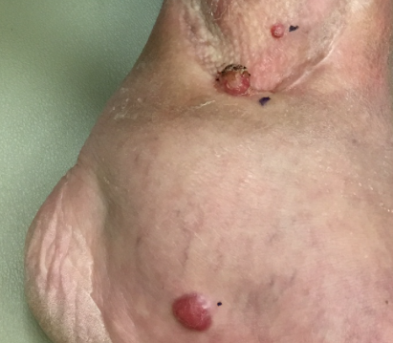
The Case of Merkel Cell Carcinoma
Increasingly common skin cancer
Very aggressive: twice as likely to metastasize as
melanoma
80%+ of cases are caused by a virus
(Merkel cell polyomavirus)
Very difficult to treat until recently
FH/SCCA is major referral center

Slide 13
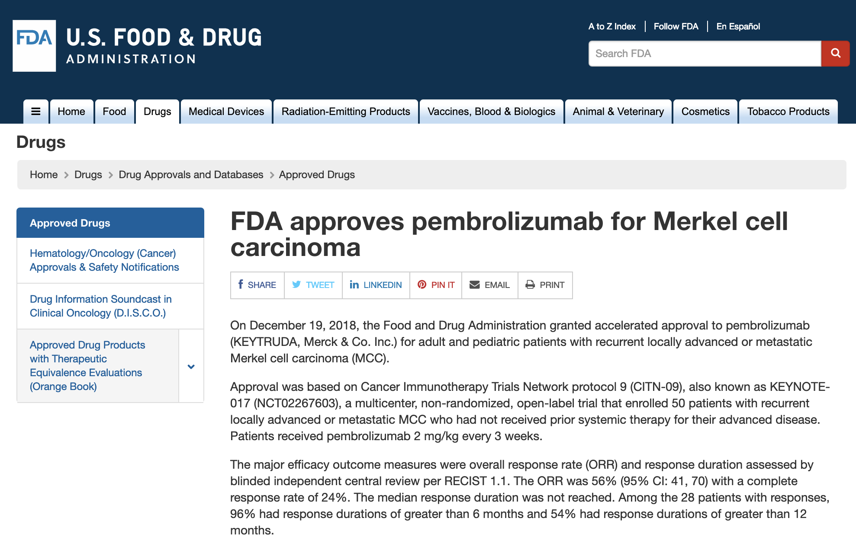
Notes:
Talk about the P01

Slide 14
FAUST analysis of CITN-09 T-cell panel samples
Cancer Immunotherapy Trials Network (CITN) phase 2 clinical trial (NCT02267603)
Patients with stage IV and unresectable stage IIIB Merkel Cell Carcinoma receiving pembrolizumab (anti-PD1) therapy
Data from 27 patients, 18 of which responded to therapy (CR/PR) for an observed response rate of 67%
T-cell panel: CD3, CD4, CD8, CD25, CD28, CD45, CD45RA, CD127, CCR7, PD1, ICOS, HLA-DR
Goal: Identify baseline T-cell predictors of response to anti-PD1

Slide 15
FAUST analysis of CITN-09 T-cell panel samples
FAUST discovered 230 total phenotypes.
Of these phenotypes, 125 contained the annotation CD3+.
Baseline (pre-treatment) samples available for 27 subjects.
18 of the 27 subjects classified as "Responders": they exhibited either a complete (CR) or partial (PR) response.
9 of the 27 subjects classified as "Non-responders": they exhibited either stable (SD) or progressive disease (PD).
We then tested the 125 CD3+ phenotypes for association with response status, and used the Bonferroni correction to adjust for multiple testing.
Notes:
We used binomial generalized linear mixed models (GLMMs) to test each sub-population for differential abundance at the baseline time point (prior to receiving anti-PD-1 therapy).
Model: (Count,Total-Count) ~ ResponderStatus + (1|subjectID) -- subject level random effect is to account for over-dispersion
Responder status was determined per RECIST1.1.
10% Bonferroni threshold used to select significant phenotypes.

Slide 16
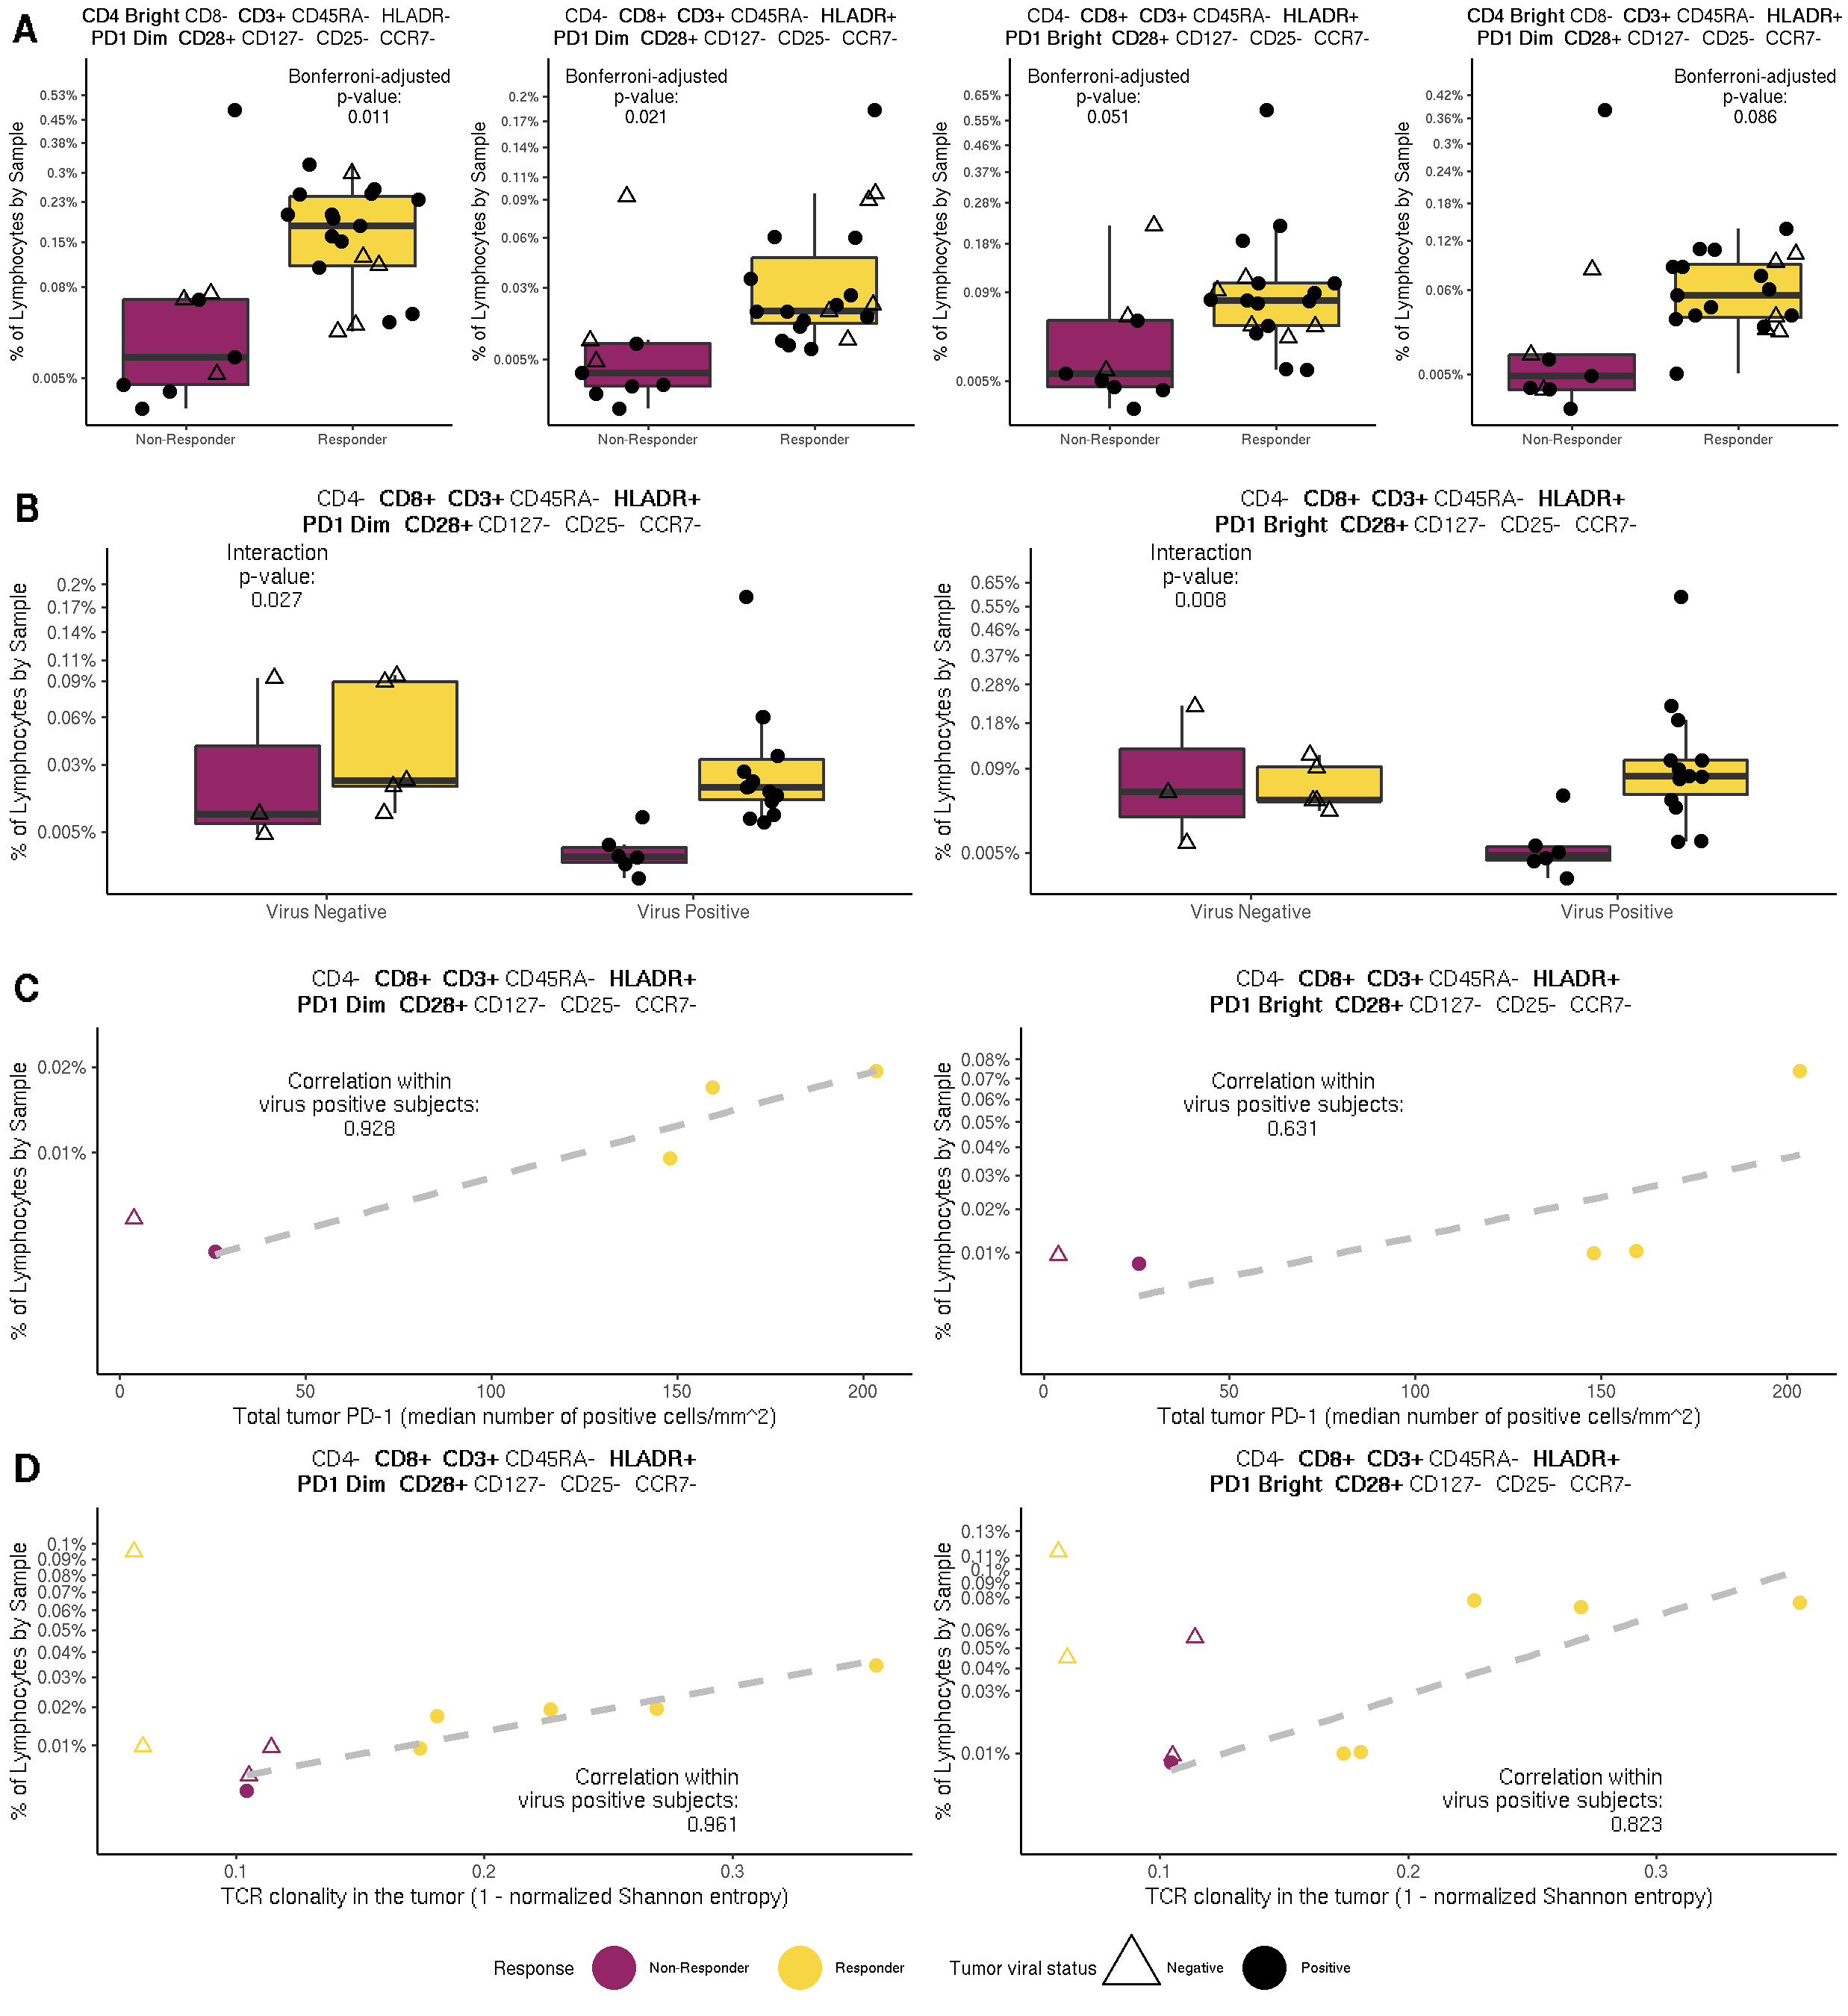
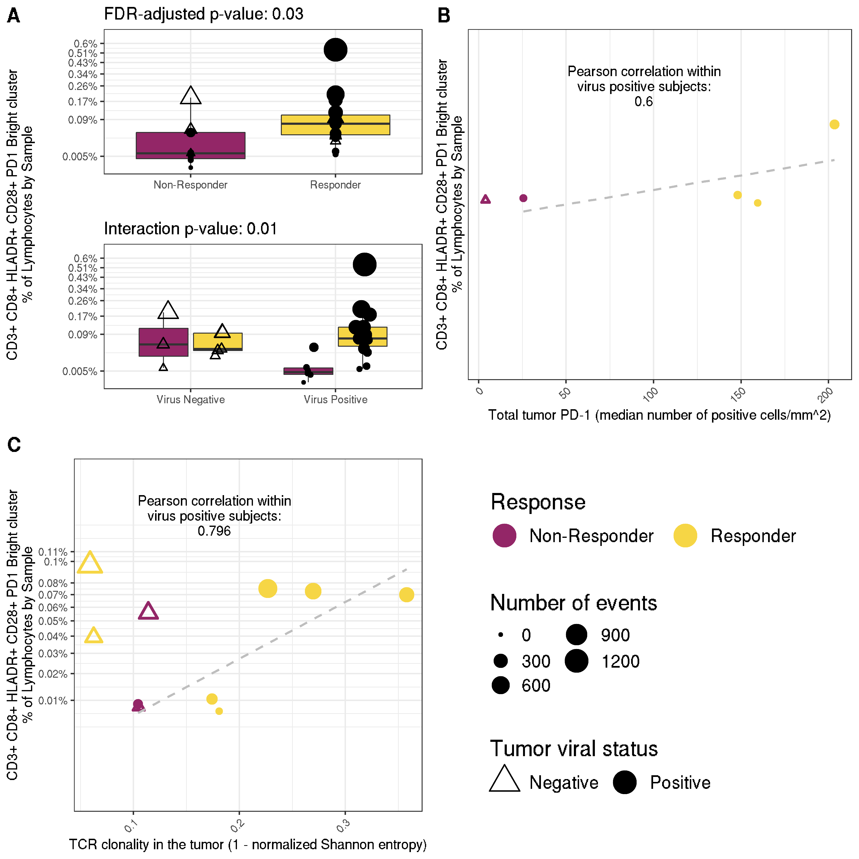
FAUST identified 4 baseline predictors
Two CD8+ predictors co-expressing PD-1 (dim/bright), CD28, HLA-DR
Two CD4+ predictors, best co-expressing PD-1 (dim) and CD28

Slide 17
Frequency of CD8+ PD1+ T-cell (in blood) correlate with tumor data
Notes:
Reports that CD8 T cells co-expressing HLA-DR and CD28 can exhibit anti-viral properties \cite{landay1993activated}, as well as reports of CD28 dependent rescue of exhausted CD8 T cells by anti-PD1 therapies in mice \cite{kamphorst2017rescue}, led us to investigate the association between the abundance of the therapeutic-response-associated sub-populations discovered by FAUST and tumor viral status of each subject.
We adapted the differential abundance GLMM to test for an interaction between response to therapy and tumor viral status in the four significant FAUST phenotypes (Figure~\ref{figure:CITN09figure}A).
This interaction was statistically significant (PD-1 dim $p = 0.027$; PD-1 bright $p = 0.008$) for both CD8+ correlates (Figure \ref{figure:CITN09figure}B).
This suggested that the CD8+ T cells may be particularly relevant to anti-tumor response in subjects with virus-positive tumors.

Slide 18
Frequency of CD8+ PD1+ T-cell (in blood) correlate with tumor data
Notes:
In order to further investigate the relevance of these CD8+ T cells, we examined published data on PD-1 immunohistochemistry (IHC) staining in tumor biopsies from the same patients (described in \cite{giraldo2018multidimensional}).
Importantly, the in-tumor PD-1 measurement is a known outcome correlate in MCC \cite{giraldo2018multidimensional}.
Limited overlap between the assays resulted in only five subjects where both flow cytometry and tumor biopsy anti-PD-1 IHC staining were available, and only four of these were virus-positive.
Nonetheless, the frequencies of the CD8+ T cells were strongly correlated (PD-1 dim $\rho = 0.928$; PD-1 Bright $\rho = 0.631$) with the PD-1 total IHC measurements within the four virus-positive subjects (Figure \ref{figure:CITN09figure}C).

Slide 19
Frequency of CD8+ PD1+ T-cell (in blood) correlate with tumor data
Notes:
We also examined published TCR clonality data generated from patient tumor samples, described in \cite{miller2018merkel}.
Ten subjects passing clonality QC were common to the two datasets, six of which were virus positive.
Frequencies of the CD8+ FAUST populations within these six subjects were strongly correlated (PD-1 dim $\rho = 0.961$; PD-1 Bright $\rho = 0.823$) with the measurement of productive clonality (Figure \ref{figure:CITN09figure}D).

Slide 20
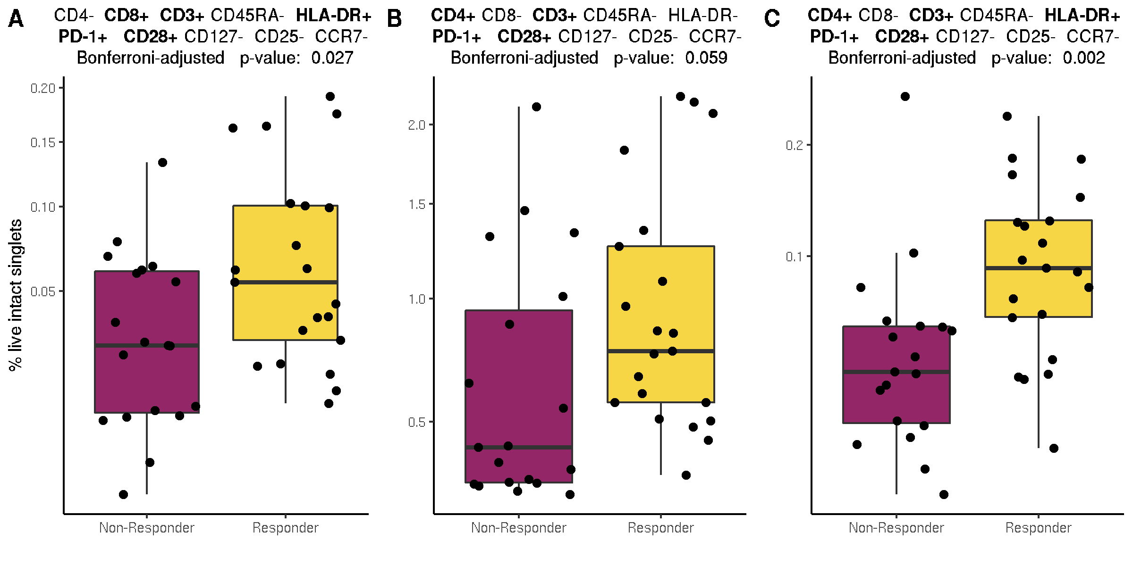
Targeted re-analysis of published anti-PD-1 data from Subrahmanyam et al (2018) confirms association between positive response to therapy and FAUST phenotypes
Data available from flowRepository.
Subrahmanyam, P.B., Dong, Z., Gusenleitner, D., Giobbie-Hurder, A., Severgnini, M., Zhou, J., Manos, M., Eastman, L.M., Maecker, H.T., Hodi, F.S., 2018. Distinct predictive biomarker candidates for response to anti-CTLA-4 and anti-PD-1 immunotherapy in melanoma patients. J Immunother Cancer 6, 18.
Notes:
Downloaded cryopreserved CyTOF PBMC data from “Distinct predictive biomarker candidates for response to anti-CTLA-4 and anti-PD-1 immunotherapy in melanoma patients” by Subrahmanyam, Priyanka B and Dong, Zhiwan …[authors omitted]… Maecker, Holden T and Hodi, F Stephen.
This figure shows relative abundance of CD4+/CD8+ cells whose phenotypes match those determined by FAUST in the MCC trial are associated with positive response to treatment by pembrolizumab in an independent melanoma study
A) Published CyTOF data from the metastatic melanoma trial \cite{subrahmanyam2018distinct} was downloaded from Flow Repository (Repository ID FR-FCM-ZYKP), and the manual gating strategy (reported in figure 1 of \cite{subrahmanyam2018distinct}) was reproduced in unstimulated samples using openCyto \cite{finak2014opencyto}. Here, we visualize our reproduction of the manual gating strategy for a single sample.
%The manual gating strategy was implented using the R package
B) Boxplots of the abundance of CD8+ PD-1+ CD28+ HLA-DR+ T cells in unstimulated baseline samples for subjects that were treated with Pembrolizumab.
This population was targeted by first using FAUST to compute annotation boundaries for the listed markers within live intact singlets for each sample, and then using those boundaries to determine counts of cells with the stated phenotype.
C) Boxplots of the abundance of CD4+ PD-1+ CD28+ HLA-DR- T cells in unstimulated baseline samples for subjects that were treated with Pembrolizumab.
This population was targeted using the same boundaries used to target the CD8 population.
Both the CD8+ and CD4+ phenotypes matched the FAUST phenotypes from the MCC trial exactly, up to the number of annotation boundaries determined for each marker.
In this trial, FAUST determined single annotation boundaries for each marker; in the MCC trial, FAUST determined two boundaries for CD4 and PD-1.
All p-values are computding from fitting the binomial GLMM \eqref{methods:baseModel} described in the sub-section \ref{methods:citn09tcelldesc} of section \ref{section:methods} to counts in theses samples.

Slide 21
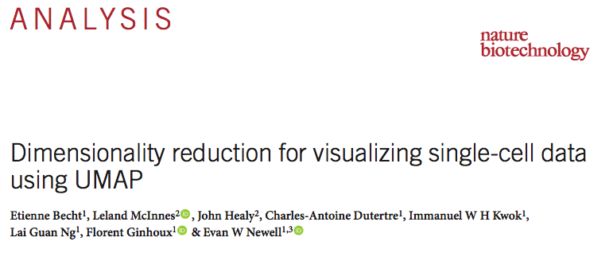
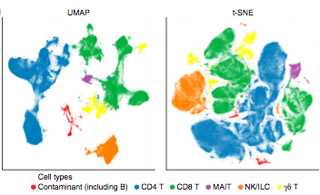
Dimensionality reduction methods often used to visualize/cluster single-cell data
Dimensionality reduction methods frequently used to embed high-dimensional data in 2-dimensions for visualization.
In recent years, linear embeddings (such as PCA) have been superceeded by t-SNE in single-cell data analysis
Both t-SNE (and the recent UMAP method) perform non-linear embeddings of high-dimensional data in lower dimensions.
These embedding techniques may better preserve high-dimensional structure in the 2-dimensional visualization.
The recent article by Becht et al. (2019) provides many comparisons between the t-SNE and UMAP methods for biological data.
The example on the left is taken from figure 1 of the listed paper.
From Becht et al. (2019)

Slide 22
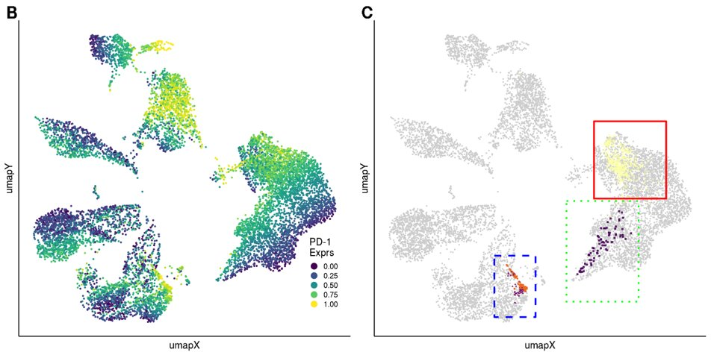
FAUST Discovers T cell Populations Associated with Outcome Not Otherwise Visible By Dimension Reduction

Slide 23
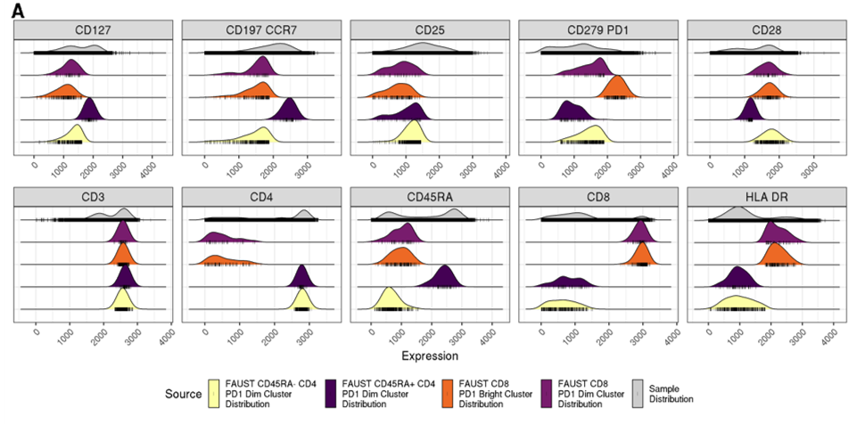
FAUST Annotated Phenotypes Match Observed Phenotypes.

Slide 24
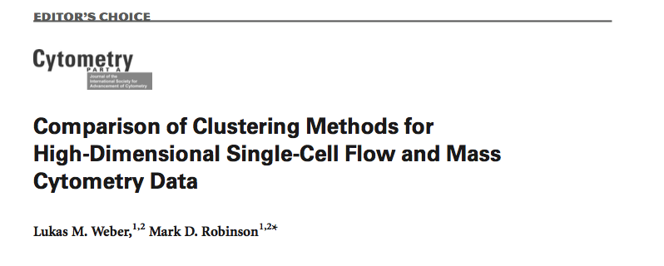
State of the field
Recent review article compares 18 clustering algorithms for flow and mass cytometry data analysis.
Conclusion: "Based on our results, we recommend the use of FlowSOM (with manual selection of the number of clusters) as a first choice for this type of analysis, since this method gave best or near-best performance across all data sets, together with extremely fast run- times." P. 1095
Also reports PhenoGraph as a high-performing method.
None of the top performers could detect our T-cell correlate

Slide 25
Summary
FAUST identified pre-treatment predictors of anti-PD1 therapy
Unbiased analysis but biologically meaningful results
Correlation with tumor data
Validated in an independent cohort
Possible thanks to FAUST phenotypic annotation
These results could not be identified by other state-of-the-art algorithms
Additional analyses available in our biorxiv manuscript

Slide 26
Analysis tools for cytometry analysis and standardization
1. Finak et al. Standardizing Flow Cytometry Immunophenotyping Analysis from the Human ImmunoPhenotyping Consortium. Scientific Reports (2016).
2. Lin et al. Identification and Visualization of Multidimensional Antigen-Specific T-Cell Populations in Polychromatic Cytometry Data. Cytometry A (2015).
3. Finak, G. et al. OpenCyto: An Open Source Infrastructure for Scalable, Robust, Reproducible, and Automated, End-to-End Flow Cytometry Data Analysis. PLoS CB (2014).
4. Aghaeepour, N. et al. Critical assessment of automated flow cytometry data analysis techniques. Nat. Methods (2013).
5. Lin et al. COMPASS identifies T-cell subsets correlated with clinical outcomes. Nat. Biotech. (2015)
Large infrastructure to manipulate and preprocess flow cytometry data in R and Bioconductor
OpenCyto suite (HDF5, FlowJo interoperability, visualization, etc)
Automated gating
Statistical modeling of cell counts
Funded by NIH R01 methods grant

Slide 27
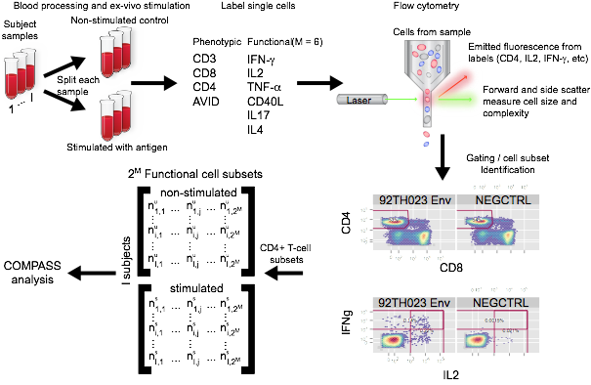
Intracellular cytokine staining (ICS) assay

Slide 28
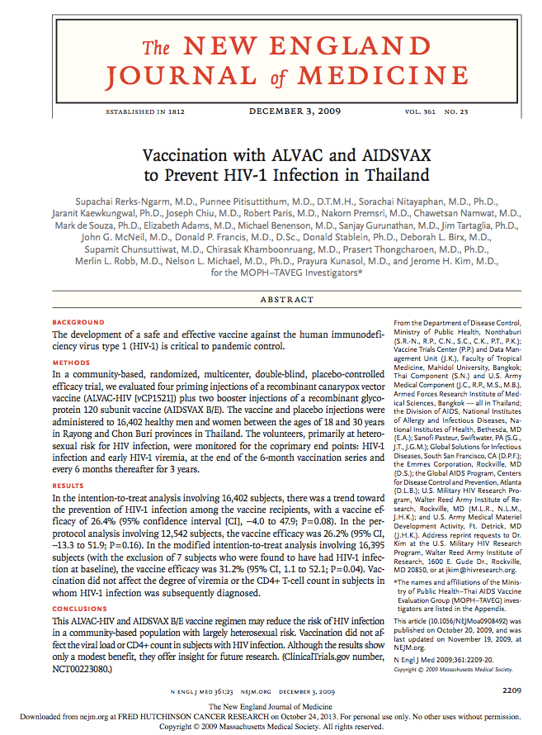
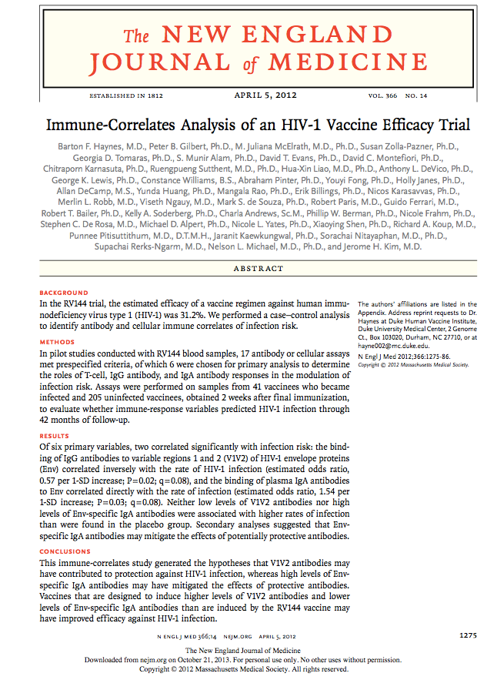
RV144 efficacy trial
31% efficacy
How did the vaccine work?
Case-control study

Slide 29
Case-control results
Six primary variables: 5 antibody and 1 cellular responses
Plasma IgA antibodies (IgA); The avidity of IgG antibodies; Antibody-dependent cellular cytotoxicity (ADCC); HIV-1 neutralizing antibodies; The binding of IgG antibodies to variable regions 1 and 2 (V1V2) of the gp120 Env (gp70V1V2); The level of Env-specific CD4+ T cells
Results:
gp70V1V2 inversely correlated with infection (estimated odds ratio, 0.57 per 1-SD increase; p=0.02)
IgA correlated with infection (estimated odds ratio, 1.54 per 1-SD increase; p=0.03)
No significant correlation with cellular responses

Slide 30
COMPASS analysis of RV144 case-control
RV144 trial: ALVAC/AIDSVAX vaccine, ~30% efficacy
No T-cell correlate identified in primary analysis (mostly focused on the magnitude of the response measured by ICS)
Need for unbiased analysis of vaccine-specific CD4⁺ T-cells based on all measured functions (CD154, IL2, IFNg, TNFa, IL17, IL4)
Developed new tool, COMPASS, to jointly model all cell subsets (i.e. cytokine combinations)
Quantify response for each subset in each subject → compute a posterior probability for each subset/subject and a polyfunctionality score (Lin et al. Nat. Biotech. 2015)
2017 Mitchell Prize award winner

Slide 31
Combinatorial Polyfunctionality Analysis of Single-cell Subsets
COMPASS:
Jointly models all combinatorial subsets using a multinomial/Dirichlet model
Use a variable selection prior to identify responding subsets (to stimulation)
Goals:
Characterize Ag-specific T-cells using ICS
Quantify response for each subset in each subject → compute a posterior probability for each subset/subject
Lin et al. Nat. Biotech. (2015)

Slide 32
COMPASS analysis of RV144 case-control
262 subjects
226 vaccinees (38 infected, 188 non-infected), 36 placebos
2 stimulation conditions per subject (stimulated with ENV, unstimulated)
CD4+ T-cells
6 functional markers: CD154, IL2, IFNg, TNFa, IL17, IL4
2⁶=64 possible combinations
Many empty combinations → 15 considered

Slide 33
Functionality scores
When many subsets are considered, it can be challenging to summarize the results
Introduce two scores that summarize these results per subject
Functionality score (FS): Mean of subset specific posterior probabilities
Poly-functionality score (PFS): Similar to FS but weigh the subset by their degree of functionality
Note that these scores do not directly depend on the frequency of antigen specific cells (Quality, not quantity)

Slide 34
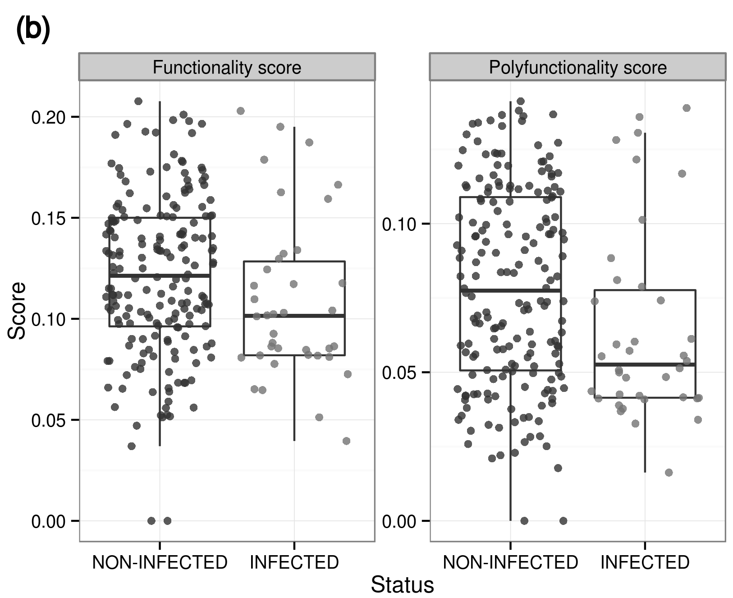
Functionality scores are inversely correlated with infection
(OR: 0.62; p=0.01)
(OR: 0.57; p= 0.0049)
* Calculated by logistic regression accounting for the sampling design. Adjusted for IgA level.

Slide 35
HVTN505 case-control
HVTN505 trial: DNA/rAd5 vaccine, no efficacy
Case-control study was performed to identify immune biomarkers correlated with infection risk
ICS assay with vaccine insert-matched peptide pools to characterize vaccine-induced T-cell responses based on CD154, IFNγ, IL2, or TNFα, Granzyme B, IL4
Applied COMPASS to both CD4 and CD8 subsets

Slide 36
Functionality scores are inversely correlated with infection
HR= 0.73, p=0.15
HR= 0.34, p<0.01
Janes et al. 2017. “Higher T-Cell Responses Induced by DNA/rAd5 HIV-1 Preventive Vaccine Are Associated With Lower HIV-1 Infection Risk in an Efficacy Trial.” The Journal of Infectious Diseases 215 (9): 1376–85.

Slide 37
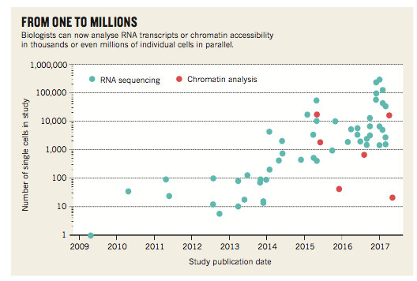
Single-cell genomics: From one cell to one million cells!
Rozenblatt-Rosen, O., Stubbington, M.J.T., Regev, A., Teichmann, S.A., 2017. The Human Cell Atlas: from vision to reality. Nature 550, 451–453.
1.3 Million Brain Cell Dataset
133 scRNA-Seq libraries
FASTQ file (3.6 Terabytes in size)

Slide 38
Challenges in single-cell genomics
Technical and statistical
Technical issues
Unwanted cell-to-cell variability
Assay failure (e.g. due to cell capture, RNA extraction)
Batch effects
Bi-modality
A gene can be off or on at the single-cell level. Standard statistical models might not be appropriate.
Large datasets
Possibly thousands of genes in thousands of cells with complex designs. Pay attention to computational implementations.

Slide 39
Methods/tools for single-cell genomics
McDavid, Finak, and Gottardo The Contribution of Cell Cycle to Heterogeneity in Single-Cell RNA-Seq Data. Nature Biotechnology (2016).
Finak, G. et al. MAST: A Flexible Statistical Framework for Assessing Transcriptional Changes and Characterizing Heterogeneity in Single-Cell RNA-Seq Data. Genome Biology (2015).
McDavid, A. et al. Modeling bi-modality improves characterization of cell cycle on gene expression in single cells. PLoS CB (2015).
Dominguez, M. H. et al. Highly multiplexed quantitation of gene expression on single cells. J. Immunol. Methods 391, 133–145 (2013).
McDavid, A. et al. Data exploration, quality control and testing in single-cell qPCR-based gene expression experiments. Bioinformatics 29, 461–467 (2013).
Optimization of primers (Roederer’s lab)
Filtering criteria for cells/probes
Statistical model for zero-inflated distributions (bimodality)
Gene-set enrichment analysis
Support for multiple single-cell platforms (NanoString, RNA-seq)
Tools development within Bioconductor

Slide 40
MAST: A unified computational framework
Model-based Analysis for Single-cell Transcriptomics
Support for multiplexed-qPCR, NanoString, and scRNA-seq
Thresholding and filtering methodology
Semi-continuous model for estimation and inference
Flexible framework for modeling effects and covariates (e.g. CDR, subjects)
Gene set enrichment analysis
Finak et al. Genome Biology (2015).
R package: https://github.com/RGLab/MAST
Builds on McDavid et al. (2013) and McDavid et al. (2014)
Andrew McDavid
Greg Finak

Slide 41
MAST performance
Among the best tools for differential expression in single-cell RNA-seq
Dal Molin, A., Baruzzo, G., Di Camillo, B., 2017. Single-Cell RNA-Sequencing: Assessment of Differential Expression Analysis Methods. Front. Genet. 8, 62.
Jaakkola, M.K., Seyednasrollah, F., Mehmood, A., Elo, L.L., 2016. Comparison of methods to detect differentially expressed genes between single-cell populations. Brief. Bioinform.
Soneson, C., Robinson, M.D., 2017. Bias, Robustness And Scalability In Differential Expression Analysis Of Single-Cell RNA-Seq Data. bioRxiv.
Crowell, H.L., Soneson, C., Germain, P.L., Calini, D., Collin, L., 2019. On the discovery of population-specific state transitions from multi-sample multi-condition single-cell RNA sequencing data. BioRxiv.
Good false discovery rate control, good power, fast and applicable to different data types

Slide 42
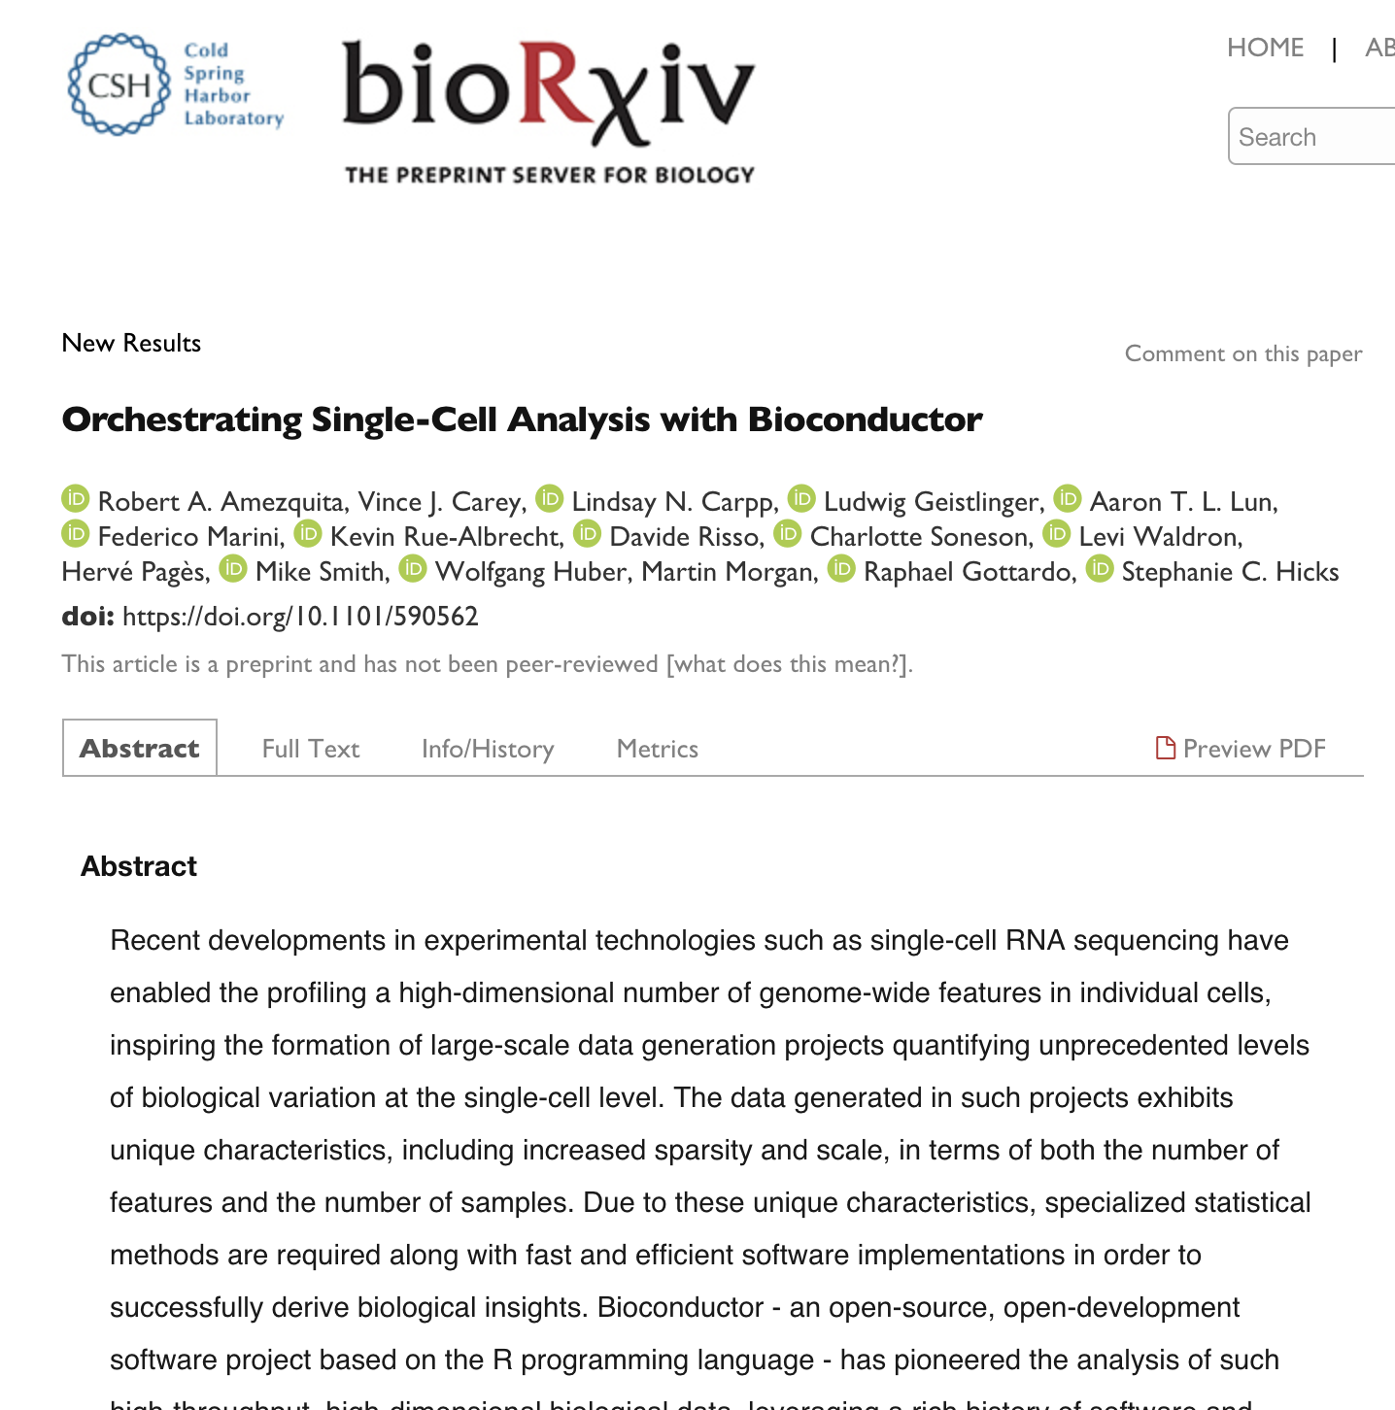
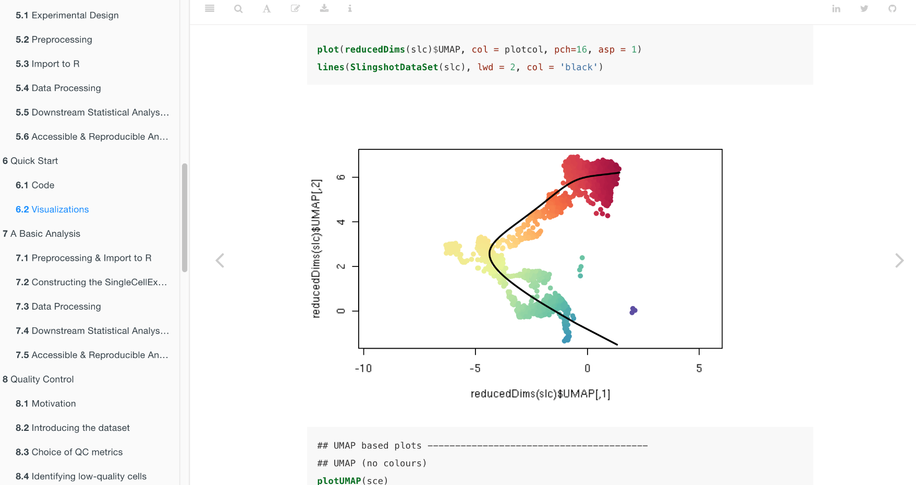
Companion book available
at osca.bioconductor.org
Rob Amezquita
Project funded by the Chan-Zuckerberg Initiative

Slide 43
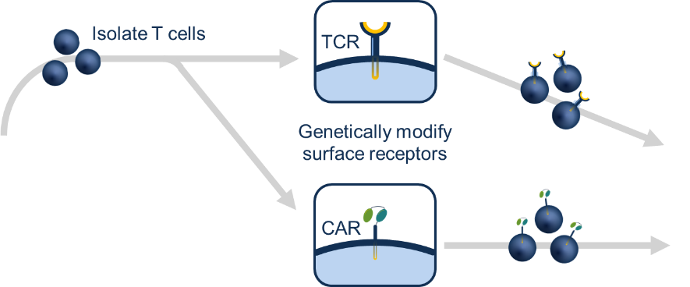

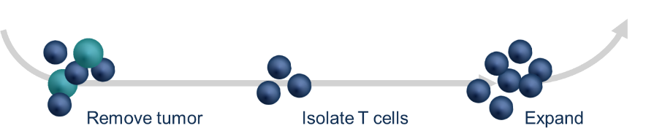


Immunotherapy: Adoptive T cell therapies
2 weeks
Tumor Infiltrating Leukocytes (TIL)
2-3 months
PATIENT
PATIENT
employ anti-tumor immune cells, either natural or engineered, to create or enhance an immune response against tumors
Remove tumor
Isolate T cells
Expand
Notes:
Slide 16
www.ScienceTranslationalMedicine.org 25 March 2015 Vol 7 Issue 280 280ps7
Adoptive cellular therapy: A race to the finish line - Carl H. June,1* Stanley R. Riddell,2* Ton N. Schumacher3*
Adoptive cell therapy is currently represented by three general approaches. TILs are produced after surgical excision of tumor and enrichment
and expansion of TILs from a disaggregated tumor biopsy sample. TCR- and CAR-modified T cells are produced from peripheral blood lymphocytes
in a manufacturing step that includes introduction of the desired receptor through viral or nonviral methods in order to engineer cells. Patients
often receive a lymphodepleting chemotherapy regimen before infusion. PBMC, peripheral blood mononuclear cell.

Slide 44
Immunotherapy: huge heterogeneity in response rates
High remission rate against cancers in patients who have failed all other therapies
> 90% response rate to CD19 CAR-T cell therapies in Acute lymphoblastic leukemia (ALL)
Only 50% response rate in Non-Hodgkins Lymphoma (NHL)
Even among responders, many patient will eventually relapse
Need to better understand response to therapy and factors impacting relapse

Slide 45
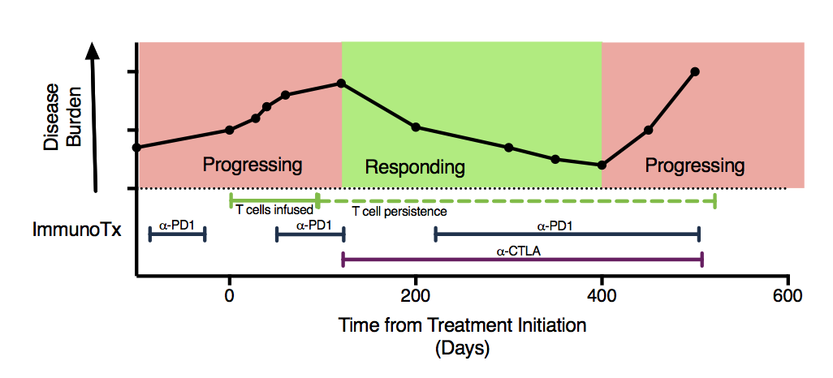
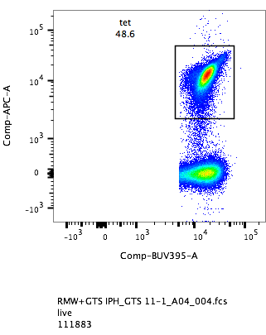
A case of immune escape
60 year old man with metastatic Merkel cell carcinoma, virus positive
Has HLA-B*3502 restricted T cells recognizing an epitope of the Merkel cell polyomavirus
Receives T cell therapy and 2 immune checkpoint inhibitors
Has an initial impressive partial response of >1 year, but then progression.
At time of progression, has antigen (MCPyV positive tumor) and persistent T cells recognizing MCPyV
Kelly Paulson
Valentin Voillet
MCPYV
TETRAMER ->
At progression,
Large # of circulating MCPyV reactive cells
CD8 ->
CAN SINGLE CELL RNA SEQUENCING HELP US DETERMINE WHY OUR PATIENT PROGRESSED?
Pilot IIRC single-cell RNA-seq grant: Kelly Paulson, Aude Chapuis, Jason Bielas, Daniel Hunter, Paul Nghiem, Valentin Voilet

Slide 46
10x Genomics single cell RNA sequencing – Patient PBMC
Time point: 1 2 3 4
Cells arrange themselves by gene expression
Different time points overlay (processing effects minimal)
1
2
3
4

Slide 47
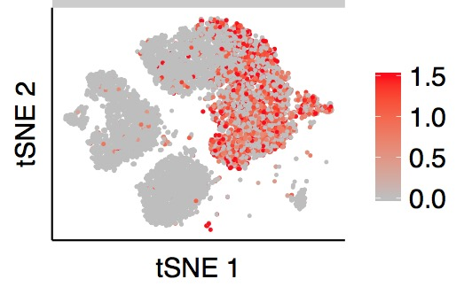
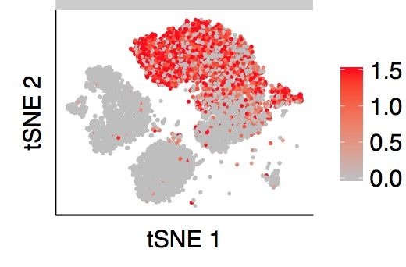
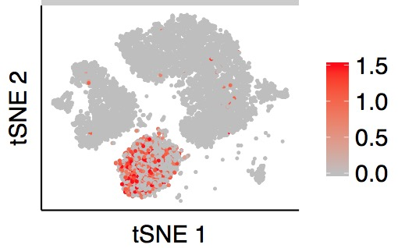
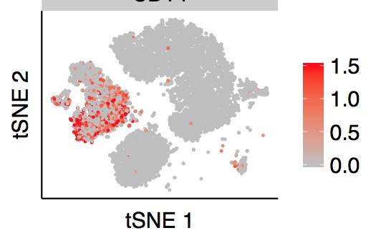
Clusters identify specific cell types
CD3
Granzyme A
CD20
CD14

Slide 48
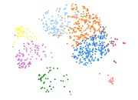
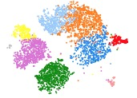
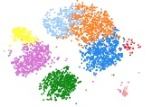
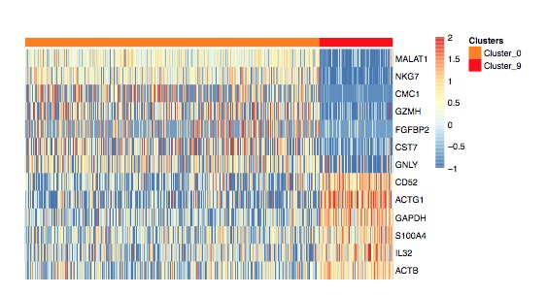
CD8⁺ effector population enriched in blood at time of treatment response
CD8⁺ T cells
Effector subset
3.5%
11.5%
2.2%
Overexpressing genes suggestive of activation, metabolism and cell division

Slide 49
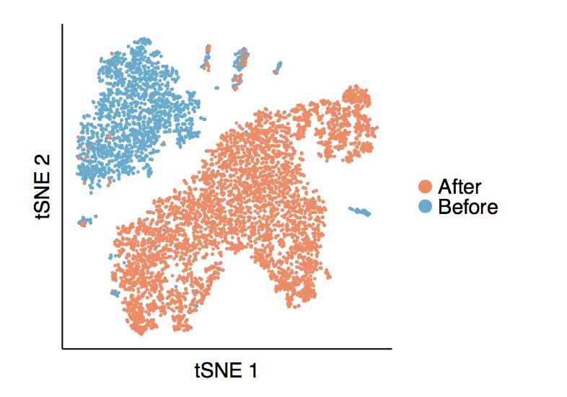
RNA expression of MCC tumor before treatment
and at the time of progression
TILs (tumor infiltrating lymphocytes), TAMs (tumor associated macrophages) and fibroblasts cluster together
Tumor cells pre- and post-treatment cluster separately
All tumor cells changed their gene-expression profile, suggestive of intense selective pressure
MCC before
MCC
after
TILs
TAMs
Fibroblasts
Tumor
Before
Tumor
After

Slide 50
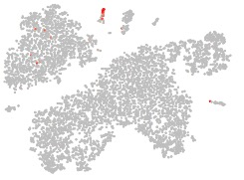
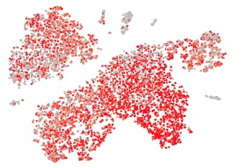
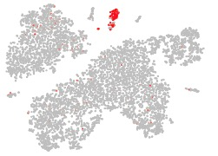
RNA expression of MCC tumor before treatment and at the time of progression
CD3 (T cells)
TILs
TAMs
Fibroblasts
Chromogranin
(tumor marker)
Tumor
Before
Tumor
After
CD68 (macrophages)

Slide 51
Merkel cell polyomavirus expression
Large T antigen expression can be detected in 11% of cells
No small antigen expression could be detected
No differences before and after response to therapy

Slide 52
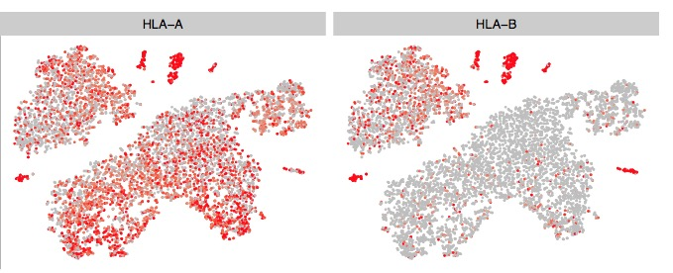
Targeted approach reveals selective HLA-B loss with immune escape post-treatment with HLA-B35 Targeted T cells
NOT TARGETED
TARGETED
TILs
TAMs
TILs
TAMs
Fibroblasts
Fibroblasts
Tumor
Before
38%
Tumor
Before
50%
Tumor
After
56%
Tumor
After
7%
Difference not significant
p<0.01
Finak et al., Genome Biology 2015

Slide 53
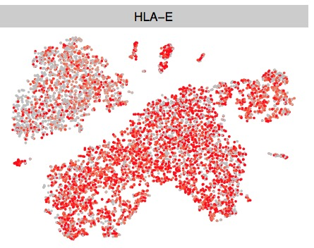
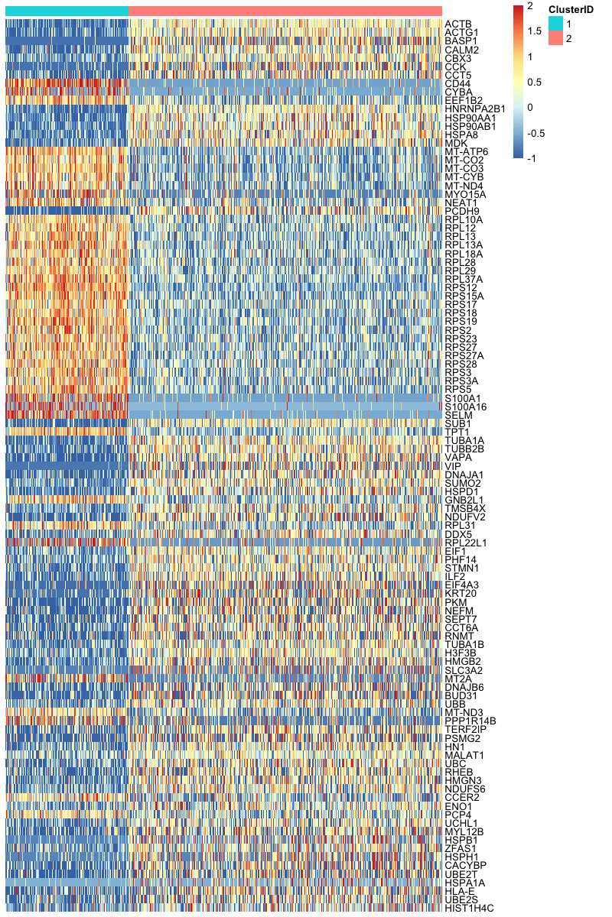
Unbiased approach: significant increase in HLA-E expression
105 most differentially expressed genes
Tumor Before
Tumor After
Tumor
Before
Tumor
After
p<0.001
HLA-E functions as an inhibitory
ligand for NK cells
Patient was subsequently
non-responsive to NK boosting strategies
HLA-E**

Slide 54
Summary
Successful application of scRNA-seq
Obstacles and mechanisms for improving the efficacy of T cell therapy
Immune escape via down-regulation of HLA-B and up-regulation of HLA-E
HLA-E upregulation suggests a mechanism for NK cell escape
Findings that couldn’t be made using traditional flow cytometry or histochemestry

Slide 55
Understanding the dynamics of adoptively transferred CD19 CAR-T cells
What happens to CAR-T cells after adoptive transfer?
Heterogeneity of CAR-Ts.
Is there preferential selection of specific phenotypes?
Can we predict expansion and persistence of CAR-T cells?
Performed TCRB gene sequencing and single-cell RNA sequencing (scRNA-seq, VDJ) to profile CD8 + CAR-T cells isolated from infusion products (IP) and blood of patients treated with CD19-specific CAR-T cells
4 patients: 2 Chronic Lymphocytic Leukemia (CLL) and 2 NHL
Collaboration with the Turtle Lab
Alyssa Sheih
Valentin Voillet

Slide 56
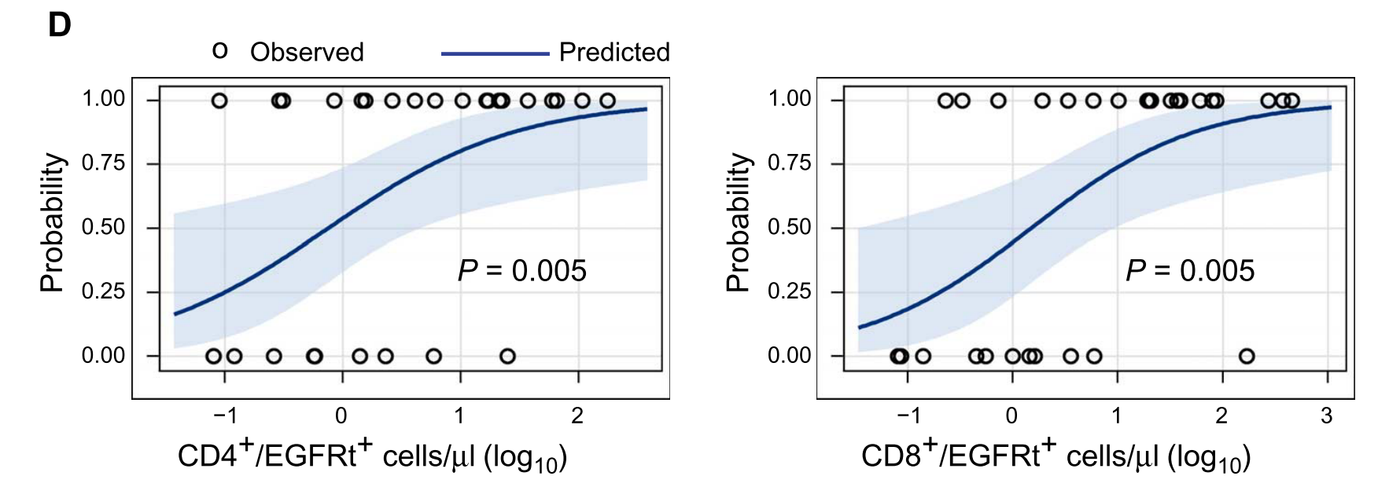
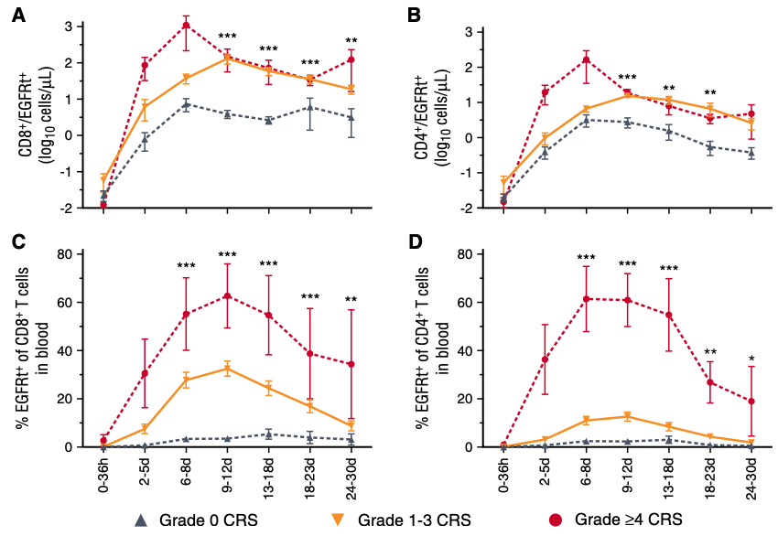
Peak CAR-T cell counts in the blood associated with response rates and increased risk of toxicity
Turtle et al. Sci. Trans. Med. 2016
Hay et al. Blood 2017
Probability curves showing likelihood of response in NHL patients according to peak CD8 CAR-T cell counts in blood
There is limited data on the clonal composition of CAR-T cells in the infusion product and after adoptive transfer.
Notes:
As you all know, CAR-T cells directed against CD19 have been remarkably successful in the treatment of relapsed/refractory B cell malignancies, in which in vivo expansion of CAR-T cells is an important factor associated with response rates and anti-tumor efficacy.
Here you can see that achieving higher peak CD8 CAR-T cell counts in the blood is associated with a higher likelihood of response in NHL patients.
However, in vivo expansion of CAR-T cells is also associated with higher risk of toxicity such as cytokine release syndrome.
Despite the importance of CAR-T cell expansion on clinical outcomes, there is very limited data on the clonal composition of CAR-T cells in the infusion product and the behavior of CAR-T cells after adoptive transfer.

Slide 57
Study Design
Infusion
Product
Early
(d+7 to 14)
TCRBV sequencing
(ALL, n = 5; NHL, n = 5)
Clonal behavior
Flow sorting
CD8⁺ CD4⁻ EGFRt⁺
Late
(d+14 to 30)
Gene expression linked to clonal behavior
10x scRNA-seq
5’ GE & V(D)J
(CLL, n = 2; NHL, n = 2)
Very Late
(> d+82)
How does the clonal behavior of CD8⁺ CAR-T cells change after infusion?
Notes:
For this study, we sorted CD8⁺ EGFRt⁺ CAR-T cells from the infusion product and from the blood early and late after adoptive transfer.
This early time point is when we see peak CAR-T cell counts in blood and late time point occurs after expansion when CAR-T cells are contracting.
In 10 patients, we performed high throughput TCRBV sequencing to study the clonal behavior of CAR-T cells after infusion.
In 4 additional patients, we performed single cell RNA sequencing to profile CD8+ CAR-T cells and this will be focus of the second half of my talk.
First, we addressed the question of how clonal diversity and clonal behavior of CAR-T cells changes after infusion.

Slide 58
Clonal diversity of CD8⁺ CAR-T cells decreased after infusion
Frequency of the top 10 most prevalent clonotypes increases after infusion.
Clonal diversity: Shannon entropy Index
IP
Early
Late
Clone rank
ALL-1
ALL-2
ALL-3
NHL-1
Shannon entropy index was calculated after downsampling the CDR3 sequences to the minimum number of productive sequences obtained.
NHL-2
NHL-3
Notes:
Next, we assessed the clonal diversity of CAR-T cells at each time point, we computed the Shannon entropy index after downsampling to account for sample size differences.
Shannon entropy index accounts for both the richness and evenness of the repertoire. Meaning it accounts for both the total number of clonotypes in the repertoire as well as the the proportion of the repertoire occupied by these clonotypes.
So if there are fewer clones in the repertoire or the repertoire is skewed and dominated by a few clones, all of these would lead to a decrease in clonal diversity.
As you can see, clonal diversity of CD8+ CAR-T cells decreased after infusion.
We hypothesized that this decrease in clonal diversity could be due to oligoclonal expansion of CAR-T cells. So we calculated the proportion of the total repertoire that is occupied by the 10 most abundant clones at each time point. This is depicted in this pie chart where the top ten clones are represented in different colors starting from the most abundant clone which is given a clone rank of 1. And indeed, after infusion, the frequency of the top 10 clones increased over time, showing expansion and dominance of the repertoire by certain clones – leading to decreased clonal diversity.
This led us to ask what is the contribution of individual CAR-T cell clones in the IP to the in vivo CAR-T cell pool?
For example, are the top ten clones in the IP the same clones that are the most abundant at the early and late time points? Do they remain dominant after infusion?

Slide 59
Single cell transcriptional profiles of infused CD8⁺ CAR-T cells are distinct from CAR-T cells in blood after infusion
Differential gene expression (DEG)
t-SNE analysis of single cell RNA-seq data (62,167 cells)
ALDOA
PKM
IP
Early
Late
Very Late
IP
Early
Late
Very Late
GPI
LDHA
PGK1
CLL-1
ENO1
GAPDH
SLC16A3
CLL-2
TIMP1
FOS
JUN
CD69
NHL-6
IL32
SELPLG
KLRC1
KLRG1
NHL-7
PLEK
FCGR3A
CX3CR1
PRF1
GZMB
GZMH
GNLY
NKG7
For tSNE analysis, the top 1000 most variable genes were used to compute the PCA. The top 15 principal components (PCs) were then down selected for tSNE visualization. 1000 iterations of the tSNE Barnes-hut implementation using a perplexity value of 30 were performed.
ITGB2
HLA-C
GZMK
FYN
NFKBIA
CXCR4
Notes:
So having said that, we first focused on the transcriptional profile of CAR-T cells by first visualizing the single-cell transcriptomes by performing t-SNE, which is a dimensionality reduction approach that allows us to look at this high dimensional data in two dimensions.
We profiled about 62,000 CD8+ CAR-T cells – and the t-SNE plot shows all these cells concatenated together. The figure on the right separates the different time points as well as the different patients.
Here, each time point is represented in a different color, which shows that the transcriptional profile of the infused CAR-T cells is strikingly different from CAR-T cells in blood after infusion.
On the other hand, the transcriptional profile of CAR-T cells at the early and late time point are very similar. Here CAR-T cells from the early time point are overlaid on top of the late time point – and the similarity can be better seen in this plot.
CAR-T cells isolated at a very late time point, about 3 months after infusion, were again different from the other time points.
This data highlights the progressive divergence of the transcriptional profile of CAR-T cells from the infusion product through the early, late, and very late time point. This can also be clearly seen when we performed differential gene expression analysis.
DEG analysis showed that CD8+ CAR-T cells in the IP expressed higher levels of genes associated with the glycolysis pathway, AP-1 transcription factors, and CD69. This is likely due to in vitro stimulation with LCL cells during manufacturing.
Compared to the IP, CD8+ CAR-T cells at the early and late time points express higher levels of genes associated with cytotoxicity – including GZMB and PRF1, which declined at the very late time point.

Slide 60
Increased cytotoxicity/proliferation in increasing clonotypes
Differentially expressed genes in IP
(IRF: increased relative frequency, DRF: decreased relative frequency)

Slide 61
Summary
Clonal diversity of CD8⁺ CAR-T cells decreased after infusion.
Individual CD8⁺ CAR-T cell clones can exhibit distinct kinetics after infusion.
CD8⁺ CAR-T cells in the infusion product were transcriptionally heterogeneous
This heterogeneity contributes to clonal behavior after infusion.

Slide 62
What’s next?
Apply FAUST to more data including CITE-seq
Leverage public databases (e.g. ImmuneSpace)
Collaboration with the Allen Institute for Immunology
New collaboration with SCRI around CD19 CAR-T cell therapies
Explore new single-cell technologies (e.g. spatial profiling)
Human Immunology Project Consortium, Gates Foundation
Immune correlates studies of vaccine efficacy for TB, Malaria and HIV
Seed Networks for the Human Cell Atlas
Single-cell epigenomics using CUT&TAG; Single-cell multi-omics (e.g. CITE-seq)
Translational Data Science IRC

Slide 63
Acknowledgments
Gottardo Lab: Andrew McDavid (Alumni), Lynn Lin (Alumni), Greg Finak, Masanao Yajima (Alumni), Valentin Voillet, Evan Greene, Mike Jiang, Rob Amezquita, Etienne Becht, Ju Yeong Kim, Evan Henrich, Chad Young, Phu Van, Jake Wagner, Helen Miller, Jason Taylor, Xing Ren, Carl Murie
Collaborators Fred Hutch: Martin Prlic, Evan Newell, Cameron Turtle, Steve De Rosa, Julie McElrath, Kelly Paulson, Aude Chapuis, Jason Bielas, Paul Nghiem, Stan Riddell, Phil Greenberg BRI: Peter Linsley Broad: Alex Shalek
VISC team: Eva Cheung, Michelle Cheung
IRC: Marion Dorer, Sheila Charles
HDC and SciComp
Funding: NIH (HIV Vaccine Trials Network, Human Immunology Project Consortium, Bioconductor) Gates Foundation (Collaboration for AIDS Vaccine Discovery, GHVAP) Fred Hutch and Bezos Family Foundation European Union's Horizon 2020 (European HIV Alliance) Chang Zuckerberg Initiative J. Orin Edson Foundation
IIRC 10X pilot project

